Slide 1


ICS5118 - Facial Emotion Recognition
Jerome Agius

Slide 2
Motivation (1)
FER
Have you ever struggled to tell how someone is feeling just by looking at their face in a video call? Wouldn’t it be helpful to have a system that automatically detects emotions in real-time?
Every day, we interact with hundreds of people, but many of us miss subtle emotional cues. What if technology could help us understand people's emotions better, improving communication and empathy?
In customer service or healthcare, understanding how people feel can make all the difference. Imagine a system that could detect and respond to the emotions of a customer or patient in an instant.
Applications
Personalised Services – Provide tailored messages, music recommendations etc.
Customer Behaviour Analysis – Tailored adverts based on emotion analysis.
Healthcare – Detecting diseases, predict psychotic disorders, suicide prevention and patient observation.
Employment – Monitor employee attention and mood.
Education – Tailored tutoring systems, detect engagement in online learning.
Public Safety – Identify emotions triggering potential terrorist threats.
Crime Detection – Spot shoplifters.

Slide 3
Motivation (2)
Issues
Privacy Risks – Analysing sensitive biometric data -> privacy concerns and unauthorised data use.
Accuracy and Bias – Inaccuracies and biases, particularly against certain ethnic groups or skin colours, leading to unfair profiling and discrimination.
Emotional Misinterpretation – Misinterpretation of emotions due to contextual factors, resulting in erroneous conclusions that can affect individuals' lives negatively.

Slide 4
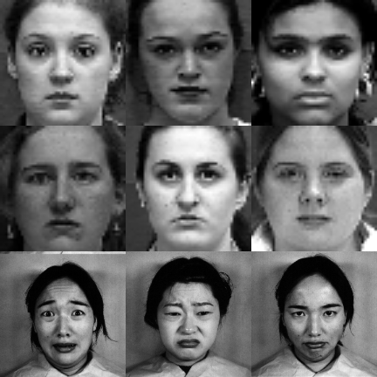
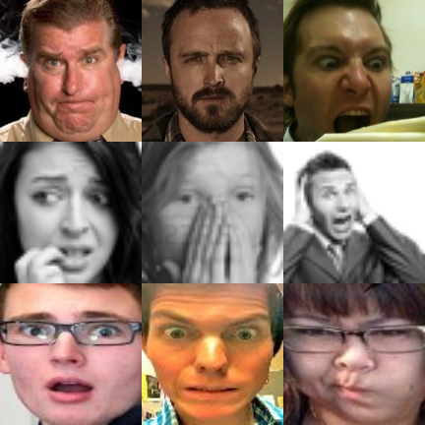
Research Topic (1)
Process
Facial Expression Recognition (FER) involves training visual models to detect human emotions from facial images. This can be broadly classified into:
In-lab FER: Models trained on controlled, structured datasets. (CK+, JAFFE)
In-the-wild FER: Models trained on real-world, unstructured images. (AffectNet, FER2013, RAF-DB)
In-Lab Images
In-The-Wild Images

Slide 5
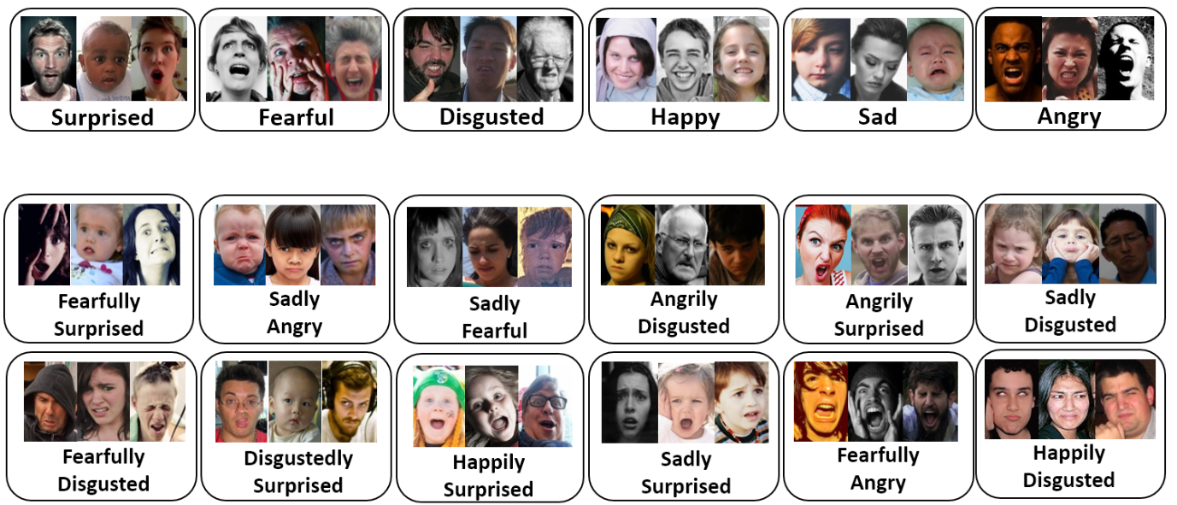
Research Topic (1)
Process
Facial Expression Recognition (FER) involves training visual models to detect human emotions from facial images. This can be broadly classified into:
In-lab FER: Models trained on controlled, structured datasets. (CK+, JAFFE)
In-the-wild FER: Models trained on real-world, unstructured images. (AffectNet, FER2013, RAF-DB)
RAF-DB Compound/Emotions

Slide 6
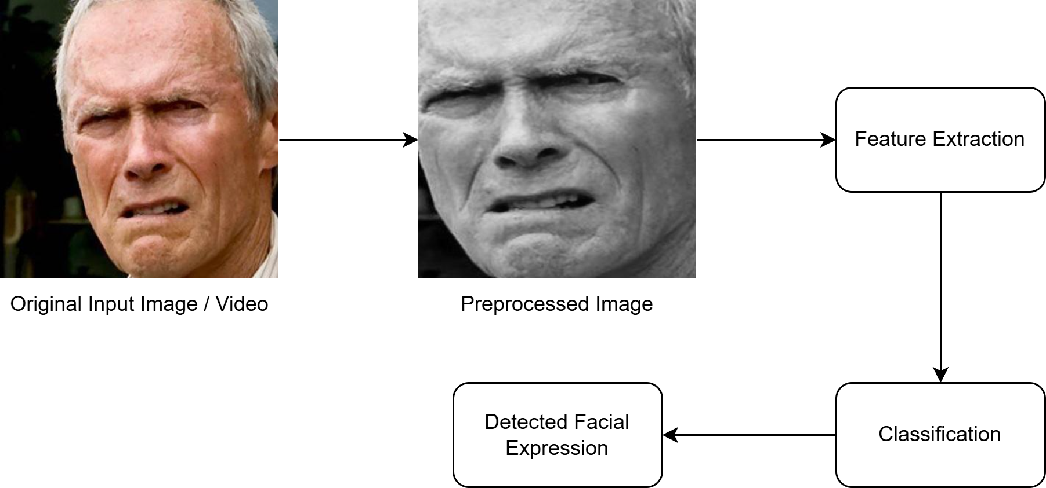
Research Topic (2)
FER Pipeline – How Does It Work
Preprocessing
Grayscale conversion, Image Normalisation, Resizing & Face Alignment
Face Detection
Haar Cascades, MTCNN, Deep-Learning face detectors
Feature Extraction
Modern approaches use Deep Learning to automatically learn spatial and temporal patterns in facial expressions
Classification with Deep Learning Models
The extracted features are then passed through the deep learning architecture
CNN, Transformers, RNN, LSTM
Emotion Prediction
Finally, the model outputs an emotional label in accordance with its training data
Generic FER Pipeline

Slide 7
Research Topic (3)
Key Challenge
Generalisability
Facial Expression Variability
Ambiguity
Occlusion
Ethical / Privacy Concerns
Benefits
Improve human-computer interaction
Enhance communication / understanding
Highlight limitations in current models

Slide 8
Aims and Objectives
Motivation
FER Applications (Healthcare, Education, Safety)
Assess Generalisability Issue
What I Want to Explore
Model Performance Replicability – Are reported results accurate and repeatable?
Cross-Datasets Performance – Do models trained on one dataset work well on others?
Model Generalisability – How well do current models generalize?
What I Hope to Achieve
Comprehensive Understanding of FER model techniques strengths and weaknesses.
Identify Best Model & Techniques (Results and Ease of use)

Slide 9
Existing Research (P1-1)
Comprehensive Review and Analysis on Facial Emotion Recognition
Authors: Amjad Rehman, Muhammad Mujahid, Alex Elyassih, Bayan AlGhofaily, Saeed Ali Omer Bahaj
Comparison
Evaluated existing models and methodologies via reported result comparison
Traditional Machine Learning Models (SVM, KNN, RF, CART, LR)
Deep Learning Models (MobileNet, CNN, DCNN, VGG16, ResNet-50)
Hybrid Models (CNN + SVM, DBN + SVM) (Feature Extraction + Classification)
Datasets Utilised (Deep Learning)
FER2013, FERPlus, JAFFE, CK, CK+, RAF-DB, KDEF
Evaluation Metrics
Accuracy (F1-score, Precision, Recall)
LINK: https://www.sciencedirect.com/org/science/article/pii/S1546221825000529

Slide 10
Existing Research (P1-2)
Evaluation Metrics
Primary Metric: Accuracy.
Other Key Metrics: F1-score, Precision, Recall (used in model-specific papers).
Deep Learning Results
Deep Learning Models outperform Traditional ML techniques in accuracy.
Drawbacks:
Extensive datasets
Substantial memory and processing power
Considerable duration for both training and testing.
Data augmentation is overall advantageous:
Enhance model flexibility
Prevent overfitting
Enhance model accuracy
Limitations
Models weren’t compared using the same datasets / hyperparameters

Slide 11
Existing Research (P1-2)
Deep Learning Results
Deep Learning Models outperform Traditional ML techniques in accuracy.
Drawbacks:
Extensive datasets
Substantial memory and processing power
Considerable duration for both training and testing.
Data augmentation is overall advantageous:
Enhance model flexibility
Prevent overfitting
Enhance model accuracy
Limitations
Models weren’t compared using the same datasets / hyperparameters

Slide 12
Existing Research (P2-1)
Critically examining the Domain Generalisability of Facial Expression Recognition models
Authors: Varsha Suresh, Gerard Yeo, and Desmond C. Ong
Comparison
Three SOTA models - ResNet50 (PT on VGGFace2), Inception-ResNet (PT on CASIA-WebFace), ResNet50 + Entropy Regularisation (PT on VGGFace2)
Three API models – Face++, Amazon Rekognition, Microsoft Azure
12 FER datasets (6 In-Lab / 6 In-The-Wild)
In-Lab: JAFFE, CK+, Oulu-CASIA, KDEF, IASLab, GEMEP
In-The-Wild: EmotioNet, SFEW, RAF-DB, Aff-Wild2, FER2013, AffectNet
LINK: https://arxiv.org/abs/2106.15453

Slide 13
Existing Research (P2-2)
Procedure
Preprocessed Images
MTCNN (Facial Detection) + Facial Alignment (Eye Location)
Grayscale
Resized (ResNet50 – 224², Inception-ResNet – 160²)
50% Horizontal Flip (Reduce Overfitting)
Maintained same hyperparameters where possible
Three experiments – Investigate Cross-Corpus domain generalisation:
Single-Source Generalisation
Multiple-Source Generalisation
Within-Setting
Cross-Setting
Leave-one-out
Commercial APIs Evalutaion

Slide 14
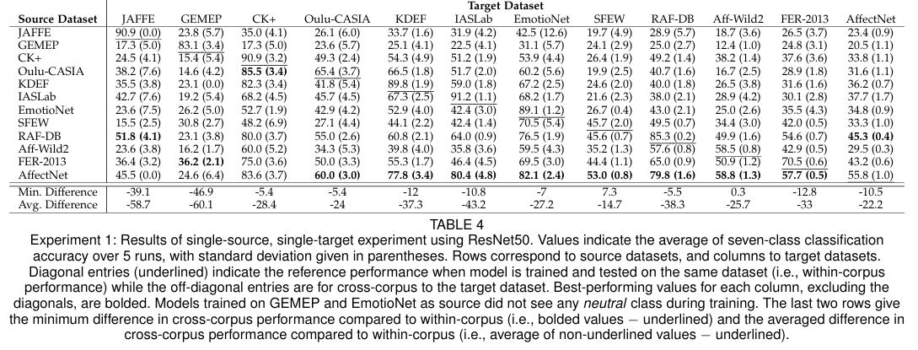
Existing Research (P2-3)
Results
Experiment 1 (Single-Source)
132 permutations
Average Accuracy (76.4% -> 42.0%)
AffectNet Best Results

Slide 15
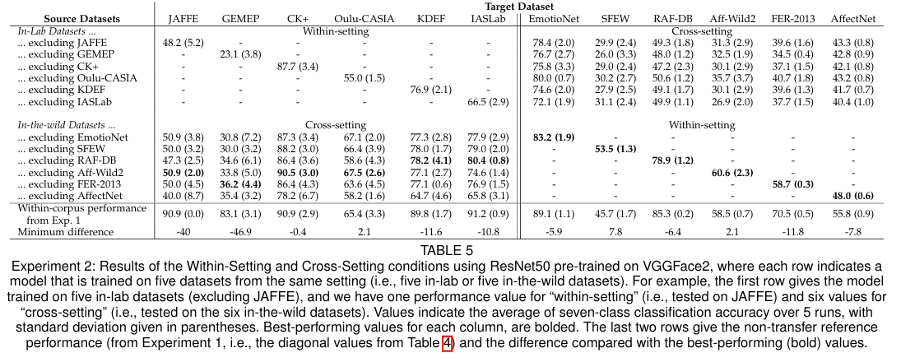
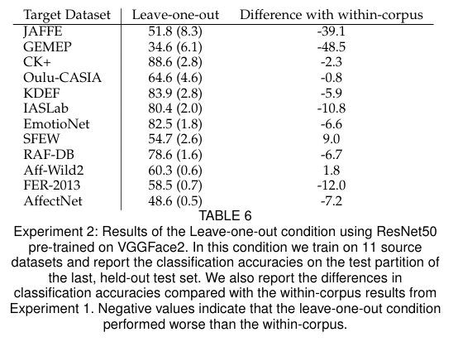
Existing Research (P2-4)
Results
Experiment 2 (Multi-Source)
Within-Setting - Average Accuracy (61.7%)
Cross-Setting - Average Accuracy (42.76%)
Leave-one-out - Average Accuracy (65.6%)
The larger the training data generally improves cross-setting performance for all models

Slide 16
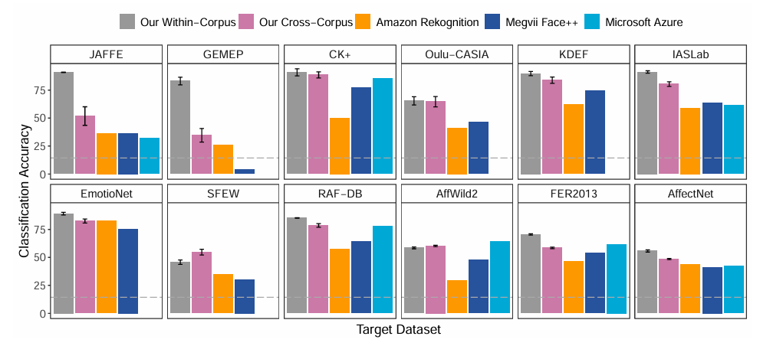
Existing Research (P2-5)
Results
Experiment 3 (Commercial API)
Only Test Sets used for results
API average performance underperforms by 25% across all datasets compared to within-corpus results
Microsoft Azure (Discontinued -> Missing Results)
Constantly Changing

Slide 17
My Plan (1)
Datasets / Models
SOTA Models & Benchmark datasets:
Prepare & Pre-Process Datasets (Face Detection & Alignment, Grayscale, Resizing)
Performance Metrics
Primary Metric : Accuracy
Secondary Metric: Precision, Recall, F1-score
Models | Datasets
ResEmoteNet | AffectNet
ResNet50 | FER2013
EmoNeXt | RAF-DB
DDAMFN++ | CK+
PAtt-Lite | JAFFE

Slide 18
My Plan (2)
Experimental Setup
Train Models on each In-The-Wild Dataset (3)
Larger -> Better overall performance (Concluded in Paper 2)
Use same hyperparameters were applicable
Evaluate Models on Testing set + Other Datasets
Arrive to a conclusion on best model considering:
Training time
Difficulty of Model Implementation
Performance Replicability
Metric Results
Generalisability (within / cross setting)

Slide 19
My Plan (2)
Models & Datasets
These SOTA Models are derived from https://paperswithcode.com/
Performance Metrics
Primary Metric : Accuracy
Secondary Metric: Precision, Recall, F1-score
Models | Datasets
ResEmoteNet | AffectNet
ResNet50 | FER2013
EmoNeXt | RAF-DB
DDAMFN++ | CK+
PAtt-Lite | JAFFE

Slide 20
Research Topic (1)
FER revolves around the idea of training visual models to detect emotions within human faces. This is primarily separated into two variations those which detect in-lab and those using in-the-wild images. However, in both cases the final required result remains the same this being an FER model able to generalise with high accuracy on unseen data thereby allowing for wide-spread application of such tools.
The general manner in which this is achieved is through the use of CNN trained on large descriptive datasets such as FER2013, AffectNet, JAFFE and others to detect important relevant facial features thereby deriving an emotional classification.

Slide 21
Existing Research (1)
Comprehensive Review and Analysis on Facial Emotion Recognition: Performance Insights into Deep and Traditional Learning with Current Updates and Challenges
Comparison
Comparing research but didn’t implement the model from scratch
Machine Learning Models (SVM, KNN, RF, CART, LR)
Deep Learning Models (MobileNet, CNN, DCNN, VGG16, ResNet-50)
Hybrid Models (CNN+SVM, DBN+SVM) (Feature Extraction+Classification)
Datasets
FER2013, JAFFE, CK+, RAF-DB
Deep Learning Results
Deep Learning techniques outperformed traditional ML models
Regrettably, deep learning-based FER methodology still has several drawbacks. Specifically, these techniques need extensive datasets, substantial memory and processing power, and a considerable duration for both training and testing.
Metrics (Accuracy – however the model papers themselves opted for accuracy, f1-score, precision, recall)
In all applications, data augmentation is advantageous due to its ability to enhance model flexibility, prevent overfitting, and generally enhance model accuracy by artificially increasing their training data.
LINK: https://www.sciencedirect.com/org/science/article/pii/S1546221825000529

